Slide 1
Mirror sales for January (year x) | In USD
Balance | 74,000
January Sales | 30,000
Addons | 7,500
Shipping | -3,000
Stress-test | -6,000
Warranty | -10,000

Slide 2
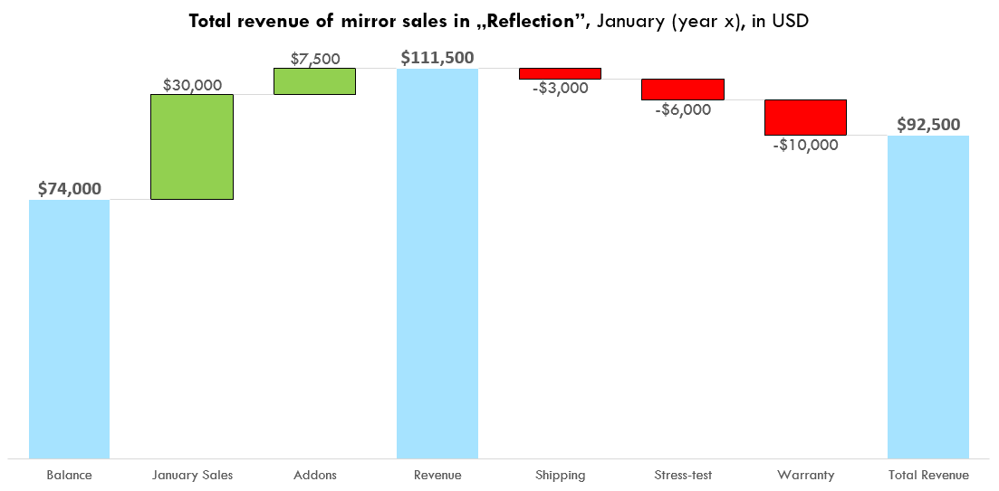

Slide 3
Let’s Practice Waterfall Chart
1. Add a Waterfall Chart and count the Revenue and Total Revenue
2. Set the Revenue as a „Total”
3. Set colors - Increase green, decrease red
4. Make Y axis (or data labels) display currency ($)
5. PowerPoint, you can’t move things around here

